Slide 1
MST and Find-Union Data Structure

Slide 2
Topics

Slide 3
Topics in this slide-deck:
Motivating Problem: Minimum Spanning Trees
This is a graph problem (ugh…more graphs?!)
Two solutions
Prim’s Algorithm (Uses graph data structure only)
Kruskal’s Algorithm (Uses a find-union structure)
Define and design the find-union to support Kruskal’s Algorithm

Slide 4
Minimum Spanning Trees

Slide 5
Spanning Tree
A spanning tree of a graph G is a subgraph of G that contains every vertex in G and is also a tree (i.e., it has no cycles)
All connected graphs have spanning tree(s)
All spanning trees have the same number of nodes (all of them)
You can construct a spanning tree by arbitrarily remove edges from cycles

Slide 6
Spanning Tree: Example
Original Graph:
Possible spanning trees:

Slide 7
Spanning Tree: Example (almost)

Slide 8
Minimum Spanning Tree
Just constructing any spanning tree is simple
Suppose edges have costs!
Cost of building tracks between two stations
Length of wire between boxes in a house
Each spanning tree has a different total cost (sum of edges included in tree)
The Minimum Spanning Tree is the spanning tree with lowest overall cost

Slide 9
Minimum Spanning Tree
Given a connected and undirected graph G=(V, E)
Find a graph G’ = (V, E’) such that:
E’ is a subset of E
|E’| = |V| - 1
G’ is connected (assuming G was connected)
Sum of cost of edges in E’ is minimum
G’ is then the minimum spanning tree

Slide 10
Prim’s Algorithm

Slide 11
Prim’s algorithm
Idea: Grow a tree by adding an edge from the “known” vertices to the “unknown” vertices. Pick the edge with the smallest weight.
G
v
known
Notes:
Pick one node as the root,
Incrementally add edges that connect a “new” vertex to the tree.
Pick the edge (u,v) where u is in the tree, v is not AND
where the edge weight is the smallest of all edges (where u is in the tree and v is not).

Slide 12
Prim’s Algorithm for MST
Pick one node as the root,
Incrementally add edges that connect a “new” vertex to the tree.
Pick the edge (u,v) where:
u is in the tree, v is not AND
where the edge weight is the smallest of all edges (where u is in the tree and v is not).

Slide 13
MST
2
v₂
v₁
4
1
3
10
v₃
2
v₄
7
v₅
5
8
4
6
v₆
1
v₇

Slide 14
MST
v1
{v1, v4}
{v1, v2}
{v4, v3}
{v4, v7}
{v7, v6}
{v7, v5}
2
v₂
v₁
4
1
3
10
v₃
2
v₄
7
v₅
5
8
4
6
v₂
v₁
v₆
1
v₇
v₃
v₄
v₅
v₇
v₆

Slide 15
Minimum Spanning Tree
MSTs satisfy the optimal substructure property
If S is an optimal solution to a problem, then the components of S are optimal solutions to sub-problems
Here: an optimal tree is composed of optimal subtrees
Let T be an MST of G with an edge (u,v) in the middle
Removing (u,v) partitions T into two trees T₁ and T₂
Claim: T₁ is an MST of G₁ = (V₁,E₁), and T₂ is an MST of G₂ = (V₂,E₂)
Proof: w(T) = w(u,v) + w(T₁) + w(T₂)
There can’t be a better tree than T₁ or T₂, or T would be suboptimal

Slide 16
Minimum Spanning Tree
MSTs also satisfy the greedy choice property
If S is an optimal solution to a sub-problem, then the min weight edge ‘e’ leaving S is always in the optimal solution for all of G
Formal Claim:
Candidate edge e with minimum cost always member of T where T is MST of G
How to prove?
Assume ‘e’ is NOT in the MST of G
Finish on board→

Slide 17
Prim’s MST Algorithm
Greedy strategy:
Choose some start vertex as current-tree
Greedy rule: Add edge from graph to current-tree that
has the lowest weight of edges that…
have one vertex in the tree and one not in the tree.
Thus builds-up one tree by adding a new edge to it
Can this lead to an infeasible solution? (Tell me why not.)
Is it optimal? (Yes. Need a proof.)

Slide 18
Tracking Edges for Prim’s MST
Candidates edges: edge from a tree-node to a non-tree node
Since we’ll choose smallest, keep only one candidate edge for each non-tree node
But, may need to make sure we always have the smallest edge for each non-tree node
Fringe-nodes: non-trees nodes adjacent to the tree
Need data structure to hold fringe-nodes
Priority queue, ordered by min-edge weight
May need to update priorities!

Slide 19
Prim’s Algorithm
MST-Prim(G, wt)
init PQ to be empty;
PQ.Insert(s, wt=0);
parent[s] = NULL;
while (PQ not empty)
v = PQ.ExtractMin();
for each w adj to v
if (w is unseen) {
PQ.Insert(w, wt(v,w));
parent[w] = v;
}
else if (w is fringe && wt[v,w] < fringeWt(w)){
PQ.decreaseKey(w, wt[v,w]);
parent[w] = v;
}

Slide 20
Cost of Prim’s Algorithm
(Assume connected graph)
Clearly it looks at every node and edge, so Ω(V+E)
Is there more?
Yes, priority queue operations
ExtractMin called V times
How expensive? Depends on the size of the PQ
descreaseKey could be called for each edge
How expensive is each call?

Slide 21
Worst Case
If all nodes connected to start, then size of PQ is V-1 right away.
Decreases by 1 for each node selected
Total cost is O(cost of extractMin for size n-1)
Note use of Big-Oh (not Big-Theta)
Could decreaseKey be called a lot?
Yes! Imagine an input that adds all nodes to the PQ at the first step, and then after that calls descreaseKey every possible time. (For you to do.)

Slide 22
Priority Queue Costs and Prim’s
Simplest choice: unordered list
PQ.ExtractMin() is just a “findMin”
Cost for one call is Θ(V)
Total cost for all n calls is Θ(V²)
PQ.decreaseKey() on a node finds it, changes it.
Cost for one call is Θ(V)
But, if we can index an array by vertex number, the cost would be Θ(1). If so, worst-case total cost is Θ(E)
Conclusion: Easy to get Θ(V²)

Slide 23
Better PQ Implementations
Consider using a min-heap for the Priority Queue
PQ.ExtractMin() is O(log(V)) each time
Called V times, so like Heap’s Construct: efficient!
What about PQ.decreaseKey() ?
Our need: given a vertex-ID, change the value stored
But our basic heap implementation does not allow look-ups based on vertex-ID!
Solution: Indirect heaps
Heap structure stores indices to data in an array that doesn’t change
Can increase or decrease key in O(log(V)) after O(1) lookup

Slide 24
Better PQ Implementations (2)
Use Indirect Heaps for the PQ
PQ.decreaseKey() is O(log(V)) also
Called for each edge encountered in MST algorithm
So O(E * log(V))
Overall: Might be better: Θ(V²) than if E << V²
Fibonacci heaps: an even more efficient PQ implementation. We won’t cover these.
Θ(E + V * log(V))

Slide 25
Kruskal’s Algorithm

Slide 26
Kruskal’s MST Algorithm
Prim’s approach:
Build one tree. Make the one tree bigger and as good as it can be.
Kruskal’s approach
Choose the best edge possible: smallest weight
Not one tree – maintain a forest!
Each edge added will connect two trees. Can’t form a cycle in a tree!
After adding n-1 edges, you have one tree, the MST

Slide 27
Kruskal’s MST Algorithm
Idea: Grow a forest out of edges that do not create a cycle. Pick an edge with the smallest weight.
G=(V,E)
v

Slide 28
MST
2
v₂
v₁
4
1
3
10
v₃
2
v₄
7
v₅
5
8
4
6
v₆
1
v₇

Slide 29
MST
2
v₂
v₁
4
1
3
10
v₃
2
v₄
7
v₅
5
8
4
6
v₆
1
v₇
v₁
v₂
v₃
v₄
v₅
v₇
v₆

Slide 30
Kruskal code
void Graph::kruskal(){
int edgesAccepted = 0;
DisjSet s(NUM_VERTICES);
while (edgesAccepted < NUM_VERTICES – 1){
e = smallest weight edge not deleted yet;
// edge e = (u, v)
uset = s.find(u);
vset = s.find(v);
if (uset != vset){
edgesAccepted++;
s.unionSets(uset, vset);
}
}
}
|E| heap ops
2|E| finds
|V| unions

Slide 31
Strategy for Kruskal’s
EL = sorted set of edges ascending by weight
Foreach edge e in EL
T1 = tree for head(e)
T2 = tree for tail(e)
If (T1 != T2)
add e to the output (the MST)
Combine trees T1 and T2
Seems simple, no?
But, how do you keep track of what trees a node is in?
Trees are sets. Need to findset(v) and “union” two sets

Slide 32
kruskal(edgelist,n) {
sort(edgelist)
for i = 1 to n
makeset(i)
count = 0
i = 1
while (count < n - 1) {
if (findset(edgelist[i].v) !=
findset(edgelist[i].w)) {
println(edgelist[i].v + “ ” + edgelist[i].w)
count = count + 1
union(edgelist[i].v,edgelist[i].w)
}
i = i + 1
}
}

Slide 33
Find-Union Data Structure

Slide 34
Union/Find and Disjoint Sets
Needs to support the following operations
void makeSet(int n) //construct n independent sets
int findSet(int i) //given i, which set does i belong to?
void union(int i, int j) //merge sets containing i and j

Slide 35
Union/Find and Disjoint Sets
Needs to support the following operations
void makeSet(int n) //construct n independent sets
Solution:
Store as array of size n. Each location stores label for that set.
0 1 2 3 4 5 6 7
0 1 2 3 4 5 6 7

Slide 36
Union/Find and Disjoint Sets
Needs to support the following operations
int findSet(int i) //given i, which set does i belong to?
Solution: Trace around array until we find place where index and contents match
Start at index i and repeat:
If a[i] == i then return i
Else set i = a[i]
0 1 2 3 4 5 6 7
0 1 2 3 4 5 6 7

Slide 37
Union/Find and Disjoint Sets
Needs to support the following operations
void union(int i, int j) //merge sets i and j
Solution: find label for each set (call find() method), then set one label to point to other
Label1 = find(i); Label2 = find(j)
a[Label1] = Label2 //OR a[Label2] = Label1
0 1 2 3 4 5 6 7
0 1 2 3 4 5 6 7

Slide 38
Union/Find and Disjoint Sets
Example:
merge(4,5)
merge(6,7)
merge(1,2)
merge(5,6)
find(1); find(4); find(6)
0 1 2 3 4 5 6 7
0 1 2 3 4 5 6 7

Slide 39
Union/Find and Disjoint Sets
Time-complexity if where n is size of array?
makeSet()
Linear: just create array and fill it with values
find()
Linear if have to trace a long way to get to label
Constant if lucky and label given as input
union()
Constant to change the label BUT…
Could be linear to find the two labels first.

Slide 40
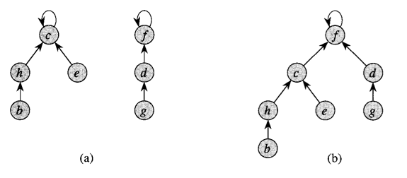
Optimization 1: Union by rank

Slide 41
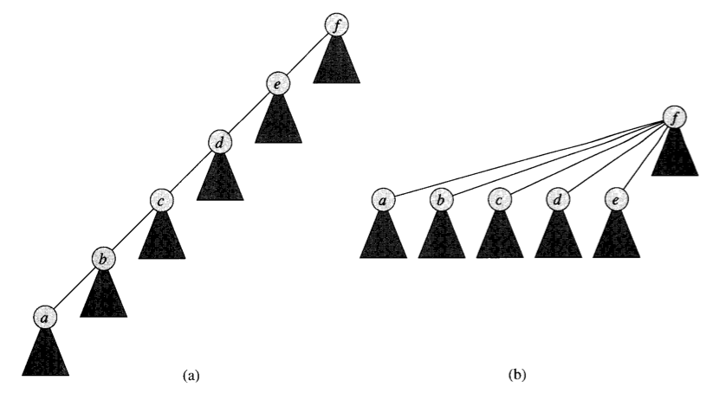
Optimization 2: Path Compression

Slide 42
Complexity for Kruskal’s
A basic analysis leads us to Θ(E*V) = O(V³)
find and union are V time
But with the optimizations presented here, it can be reduced to Θ(E * log(V))
find is amortized log(V)
union is constant (amortized log if doing find first)

Slide 43
Summary

Slide 44
What did we learn?
Minimum Spanning Trees
What they are. Motivations, etc.
Prim’s Algorithm
Nice graph algorithm for solving MST problem
Kruskal’s Algorithm
Another algorithm for solving MST problem
Nice excuse to introduce the find-union data structure
Find-union
How to implement
How to optimize

